Slide 1
Mobility for more
liveable cities

Slide 2
We are the largest European innovation
community for urban mobility
40+ CITIES
NATIONAL GOVERNMENTS
IN 33 COUNTRIES
LARGE ENTERPRISES, SMEs
AND START-UPS
300+
EU INSTITUTIONS
ORGANISATIONS
NON-GOVERNMENT
ORGANISATIONS (NGOs)
UNIVERSITIES
RESEARCH
INSTITUTES
STUDENTS
Status August 2022

Slide 3
EIT Urban Mobility is accelerating
the urban mobility transition
Europe
Talent to
business
National
Cities
Mobility for
more liveable
urban spaces
Match and connect
Innovations to market
Start-ups to scale
Ecosystems

Slide 4
Our impact numbers
Match and connect
Talent to business
Innovations to market
Start-ups to scale
15 000+
15 000
70+
197
visitors to Tomorrow.Mobility
World Congress, our flagship event
Professionals trained by
Competence Hub
innovation projects
supported (since 2020)
start-ups
supported
114
950 000+
23
77M+
Solutions showcased on
digital platform
views on EIT Urban Mobility
learning channel (Web TV)
solutions launched
to the market
of investment raised by
our venture investment
start-ups portfolio

Slide 5
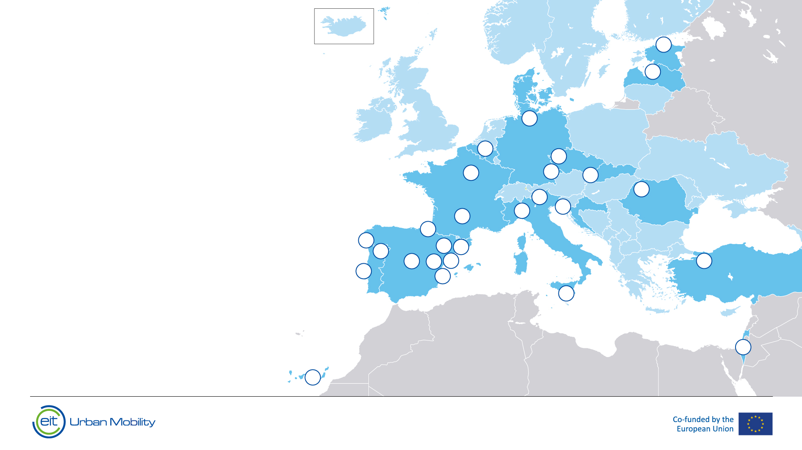
Creating impact in cities
across Europe
51
PILOTS IN
27
CITIES
Status August 2022

Slide 6
We focus on innovations that most efficiently support cities on their way to net zero
Future mobility
Active
mobility
Public
realm
Sustainable city logistics
Mobility
and energy

Slide 7
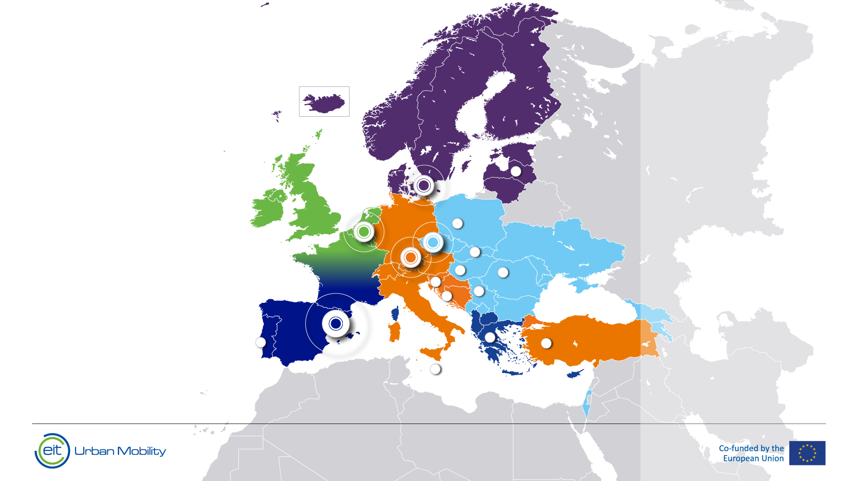
We are the leading network for
urban transport innovation across Europe
Regional Innovation
Scheme
Hub locations
SOUTH
Barcelona
NORTH
Copenhagen
WEST
Helmond
EAST
Prague
CENTRAL
Munich
HEADQUARTERS: Barcelona
Portugal
Greece
Latvia
Poland
Slovakia
Hungary
Romania
Serbia
Slovenia
Croatia
Malta
Türkiye
Status August 2022
Status August 2022

Slide 8
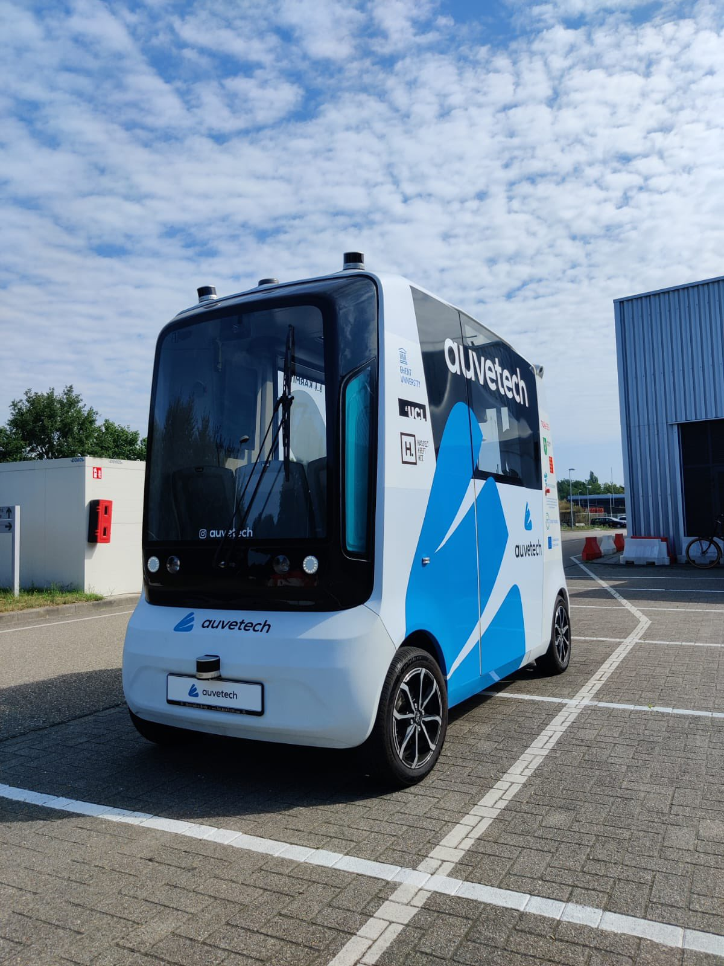
The project aims at delivering shuttle and logistics services that are sustainable, transferrable and autonomous among various European cites. The robust transnational safety framework phases out on-board safety operators & introduces remote operators who overlook a number of services simultaneously.
Powered by:

Slide 9
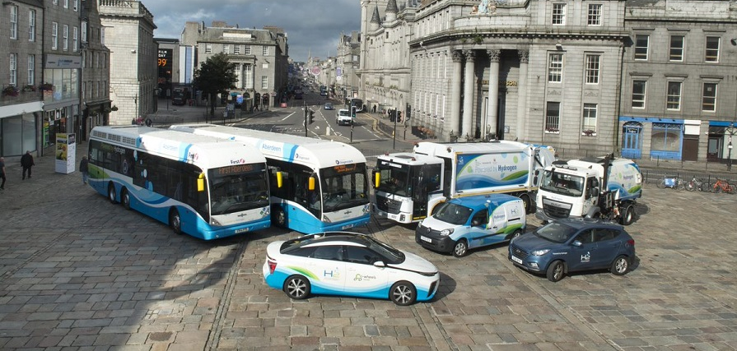
H2cities
H2 Product Partners
H2 Knowledge Partners
H2 Funding Partners
Propelling Cities to the Forefront of the EU Hydrogen Valley Strategy with 16+ EU Entities
H2 Cities
H2 SMEs
Creating H2 Reference Cities
Showcasing Five Types of Mobility
Developing Infrastructure for H2-Driven Economies of Scale

Slide 10
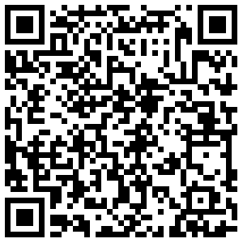
Find out more about our innovation calls

Slide 11
EIT Urban Mobility Innovation Hub East
eiturbanmobility.eu
EIT Urban Mobility Innovation Hub East, s.r.o.
Národní 135/14
110 00 Prague
Czech Republic
Pavel Vrba
pavel.vrba@eiturbanmobility.eu
Connect with us
More Information
eiturbanmobility.eu
@EIT Urban Mobility
@EIT Urban Mobility
@EIT Urban Mobility
@eiturbanmob
@EIT UrbanMob

